Slide 1
Higher Biology
Metabolism & Adverse Conditions
Mr G R Davidson

Slide 2
Adverse Conditions
There are many environments where conditions may be extreme and beyond the tolerable limits for normal metabolism, e.g.
Extreme heat
Extreme cold
Drought
Lack of food
Animals either need to adapt to these conditions or avoid them if they are to survive.

Slide 3
Surviving Adverse Conditions
Organisms can lower their metabolic rate in order to conserve energy.
We call this dormancy.
Dormancy is a part of the life cycle of the organism where growth & development are halted on a temporary basis.

Slide 4
Predictive Dormancy
Predictive dormancy happens when the organism becomes dormant before the adverse conditions arrive.
It is generally genetically controlled.
If the seasons are predictable, the organism can use certain factors to respond, e.g. trees shedding their leaves in winter.

Slide 5
Consequential Dormancy
Consequential dormancy occurs after the adverse conditions have started.
It is found in regions where the climate is more unpredictable.
The biggest advantage is that the organism can remain active for longer.
The disadvantage is that if the climate suddenly worsens, many organism may die before they can become dormant.

Slide 6
Hibernation
Hibernation is a type of dormancy employed by animals to survive harsh winter conditions.
The animal will normally increase its consumption of food before hibernation and store it as fat.

Slide 7
Hibernation
It will then lower its metabolic rate which will result in a drop in body temperature, heart rate and breathing rate.
These steps allow the animal to survive long periods of low temperatures as its energy expenditure is lowered also.

Slide 8
Aestivation
Aestivation is like hibernation but in the heat or drought.
In some environments the temperature can become so hot that the animal needs to find somewhere to shelter away from the intense conditions.
This can be an underground burrow where it is cooler and damper.

Slide 9
Daily Torpor
Daily torpor is a very short term kind of hibernation.
The animal’s metabolic rate becomes reduced for a part of the day as the animal rests.
It is common among small birds and small mammals because they have such a high surface area : volume ratio.

Slide 10
Daily Torpor
This means they require much more energy to survive.
Therefore, a period of torpor allows the organism to conserve energy.

Slide 11
Avoiding Adverse Conditions
Firstly, it is important to remember that there is a difference between “surviving” and “avoiding” adverse conditions.
Migration is a technique used by a lot of animals to avoid extreme conditions.
It involves the movement of a population from one area to another over a fairly long distance.

Slide 12
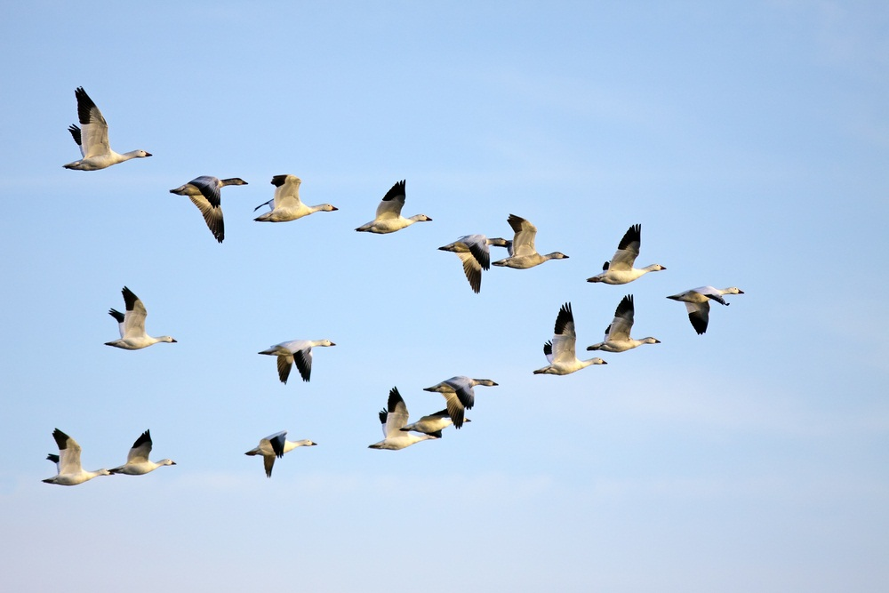
Migration

Slide 13
Innate Behaviour
An organism’s migratory behaviour is thought to be inherited.
Innate behaviour is inherited and inflexible and therefore the entire species performs the same migratory behaviour each year.

Slide 14
Learned Behaviour
Learned behaviour develops with the organism and is based on experience.
It is generally flexible and is the result of watching others or trial and error.
Migration is a result of both innate and learned behaviour.
Scientists have a number of techniques used to study migration including ringing birds legs, attaching transmitters, marking animals, etc.

Slide 15
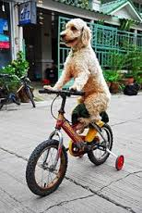
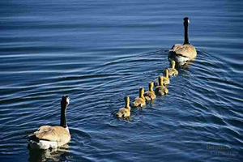
Behaviour
Learned
Innate

Slide 16
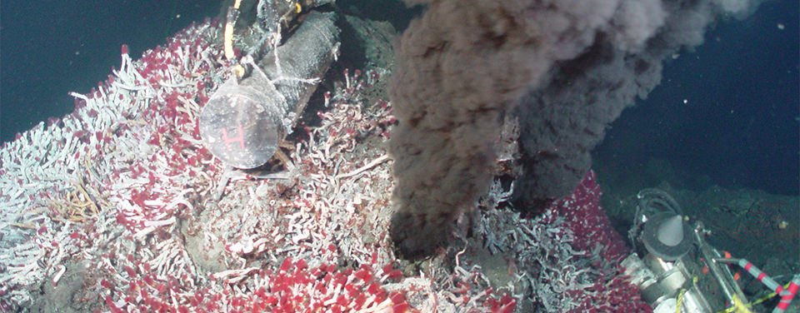
Extremophiles
Most extremophiles belong to the group archaea but some are bacteria.
Extreme thermophiles can survive in temperatures up to 80ºC in places like hot springs and volcanic vents.

Slide 17
Extremophiles
Extremophiles are organisms which live under extreme conditions that most other organisms would find lethal.
Examples include:
Extreme heat (>40ºC)
Extreme cold (<5ºC)
pH
Salinity

Slide 18
Extremophiles
Extreme cryophiles can survive for long periods of time in ice in places such as the Arctic and Antarctica.
These organisms have the ability to survive in extreme conditions due to the fact that they possess unusual enzymes capable of functioning at extreme temperatures, e.g. taq polymerase which is heat tolerant and used in the PCR.

Slide 19
Extremophiles
Some extremophiles can make use of substances like hydrogen sulphide by using high energy electrons to regenerate ATP.
This results in the production of sulphuric acid.

Slide 20
Extremophiles
Methanogens are anaerobic microbes which can generate hydrogen and ATP and produce methane which is a by-product.
These organisms cannot live in the presence of oxygen.

